Slide 1

Merrimac River Rowing Association
Year 2014 Review
Dec 9, 2014
Prepared by Karen Scammell, John Ballantine, Bronwyn Chapman

Slide 2
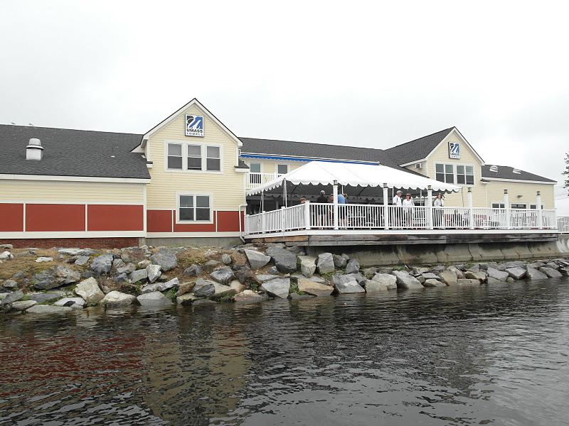
Agenda
Call to order
Reading and Approval of
November meeting minutes
Review of CY2014
  Membership
  Programs
  Regattas
  Equipment
Proposal for Base
Membership and Payment
Volunteer Recognition and Call for Committee Volunteers
Elections for Officers
New Business
Adjourn

Slide 3
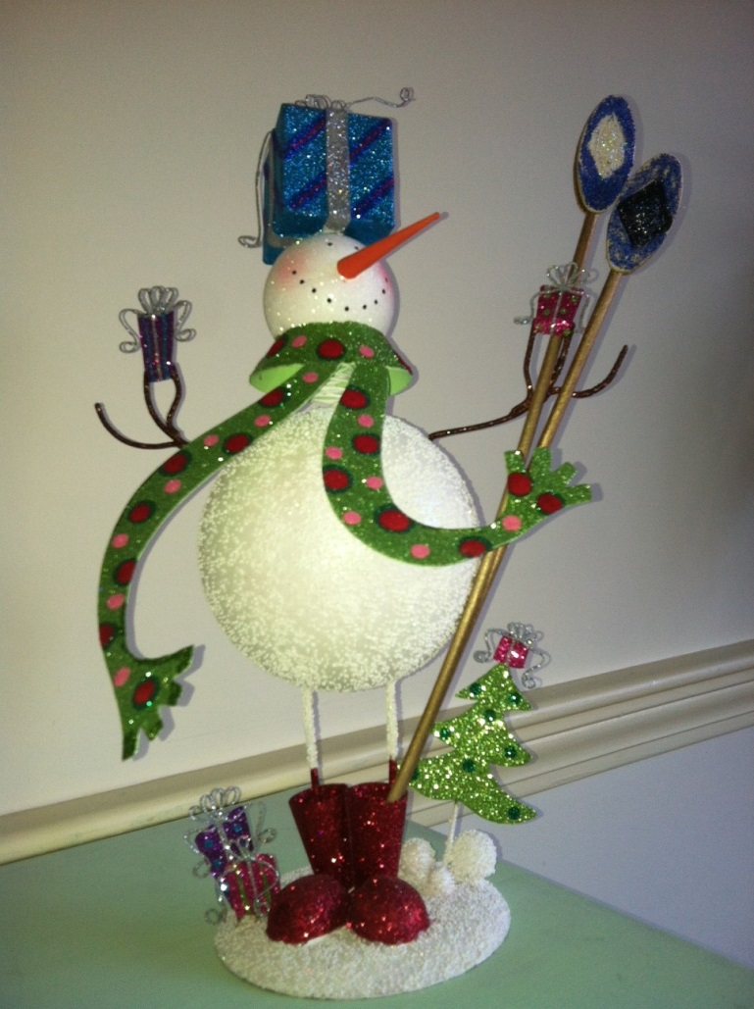
Nov Meeting Minutes
Reading and Approval of November Meeting minutes

Slide 4
Safety Message:
  To be delivered by member of Safety Committee

Slide 5
2014 – Budget and Program Objectives
We were budgeted to make an operating profit of $8.5K; and after reserve for boat depreciation, would have a net result of $500.
Grow the MRRA to beyond 100 members
Continue Learn to Scull with a paid coach
Grow Sweep rowing with increased programs and professional coaching
Run the Festival Regatta with Break-Even
Run a successful, profitable TRR

Slide 6
2014 – Budget and Program Objectives - RESULT
We were budgeted to make an operating profit of $8.5K; and after reserve for boat depreciation, would have a net result of $500.
  Operating loss of $2166 (not incl regattas)
Grow the MRRA to beyond 100 members
  104 PAID MEMBERS (increase from 84 in 2013)
Continue Learn to Scull with a paid coach
  Ran LTScull 2 but not enough for LTScull 1
Notes:
More on the loss coming up

Slide 7
2014 – Budget and Program Objectives - RESULT
Grow Sweep rowing with increased programs and professional coaching
  We ran LTSweep with 7 people at reduced rate
  Professional coaches of Mark Lewis, John Cotter and KC Lumbard
Run the Festival Regatta with Break-Even
  Made $4353 on Festival
  Added USRowing NEMA event at $5054 profit
Run a successful, profitable TRR
  Increased boats to 764 entries, 3rd launch location

Slide 8
Membership
104 Full Paying Members
 | Log Book Sculling | Private Rack space | LT Scull 1 | LT Scull 2 | Open Sweep | LT Sweep | Masters Sweep
2014 | 41 plus 24 Student | 19 | 0 | 9 | 4-6 | 7 | 8-10
2013 | 45 +11 paid reduced fee | 21 | 14 | 9 | 12 (I) 7 (II) 4 (III) | 0 | 16 (I) 11 (II)
2012 | 45 (+15) | 22 | 11 | 16 | 27 | 8 | 18
2011 | 42 | 21 | 6 | 8 | 26 | 11 | 16
2010 | 50 | 19 | 7 | 7 | 12 | 7 | 8
Notes:
Sweep 30% of membership if we include LTSweep which had good retention

Slide 9
Membership –categories
Continued a reduced rate $100 Off-Peak Sculling
  Can row after 9am any day
  No boat reservation privileges
  5 rowers opted for this
Expanded Student Sculling
  Offered $65 membership and $50 for restricted sculling
  Greatly increased participation with UML students
  24 total (typically is 2-4 any given summer)
No Junior Sweep Program – run by UML instead

Slide 10
MRRA 2014
Financial Results
Bronwyn Chapman
And Karen Scammell
December 9, 2014

Slide 11
Programs slowing / growth in regattas
MRRA and TRR combined | 2011 | 2012 | 2013 | 2014 (est)
Beginning bank balance | 51,778 | 71,413 | 98,988 | 99,293
Operating results
Income | 49,040 | 56,850 | 40,638 | 34,277
Expenses | (41,419) | (49,154) | (43,642) | (34,443)
Operating Profit | 7,621 | 7,696 | (3,004) | (166)
(before boat reserve 8k)
Capital purchases | (10,870) | (5,320) | (28,445) | (16,400)
equipment sales | 2,850 | 350 | 1,600 | 2,500
 | (8,020) | (4,970) | (26,845) | (13,900)
Regattas
Income | 73,563 | 73,616 | 83,363 | 95,146
Expense, w/LHS donation | (52,729) | (48,767) | (55,517) | 62,787
Net cash flow | 20,034 | 24,849 | 27,846 | 32,359
Ending bank balance | 71,413 | 98,988 | 96,985 | 117,586
CY2009: No Festival Regatta
Notes:
OI down $6k, but Expenses down $9k

Slide 12
MRRA 2014 Budget results and 2013 *reformatted 2014*
Revenues 2014(f) actual 2013 bud 2013
membership ** 11,510 8,035 19,750 18,450
rack fees 6,300 6,650 6,650 7,150
LT scull 5,400 2,540 5,600 4,800
Sculling ** 31,120 22.045 7,520 600
Sweep programs 9,670 5,692 29,190 9,650
sub-total $52,300 $35,772 $68,710 40,638
Expenses
UML payments 15,000 14,400 15,000 14,400
insurance 4,100 4,444 3,500 3,772
maintenance 5,000 2,811 5,000 4,257
operating 2,650 2,963 3,850 10,151
scholarships/charity 1000 1000 1,000 800
annual party 1,500 2,000 1,500 1,500
Sweep & programs 14,651 6,025 26,844 8,762
sub-total (43901) (35,743) (56,694) (43,642)
OPERATING PROFIT $8,399 $ 29 $12,016 (3,004)
* Membership only has the base fee; put all logbook and sculling into sculling in 2014
Notes:
Prog P&L next page

Slide 13
Program P&L 2014
Program P & L |  |  | Base | ClubScull | Rack | LTScull | LTSweep | MasterSw | OpenSw | TOTAL
Revenue |  |  | 8,775 | 12,855 | 6,650 | 1,800 | 2,032 | 2,500 | 1,160 | 35,772
Expense |  |  | 15,952 | 6,598 | 5,244 | 1,741 | 1,866 | 4,126 | 916 | 34,443
Profit programs |  |  | (7,177) | 6,257 | 1,406 | 60 | 166 | (1,626) | 244 | 1,329
boat depreciation |  |  |  | (2,800) | - | (1,600) | (1,200) | (1,200) | (1,200) | (8,000)
 |  |  |  | 35% | 0% | 20% | 15% | 15% | 15%
After reserve |  |  | (7,177) | 3,457 | 1,406 | (1,541) | (1,034) | (2,826) | (956) | (6,671)
After sale of boats |  |  |  | 2,500 |  |  |  |  |  | 2,500
Operating profit (Loss) |  |  |  |  |  |  |  |  |  | (4,171)
Festival Regatta |  |  |  |  |  |  |  |  |  | 4352
NEMA |  |  |  |  |  |  |  |  |  | 5054
Net Results for 2014 |  |  |  |  |  |  |  |  |  | 5,235
Notes:
Base loss means membership didn’t cover UML + Insurance + Etc
Continue to refine MSWEEP pricing, all progs for that matter. Rev on MSWEEP should have been closer to $5k ($250 x 10 x 2).

Slide 14
Membership Base is $153/person
 | Budget Amt |  |  | Base Allocation
Payments to UML | $14,400 |  |  | $9,600
Equipment Maintenance/ repairs | 2,811
Insurance | 4,444 |  |  | 889
Safety | 324 |  |  | 324
Social | 150 |  |  | 150
Annual Party | 2,000 |  |  | 2,000
US Rowing membership | 350 |  |  | 350
Scholarships - Charity | 500 |  |  | 500
Advertising /web | 519 |  |  | 519
Other (misc, stamps, etc) | 1,620 | Tax prep |  | 1,620
 |  | TOTAL |  | $15,952
Notes:
Is Budget amount for 2014 or 2015?
This is the principle calculation for recommending the base fee increase from $125 to $153.

Slide 15
Comments budget / actual 2014
Base club expenses are higher than are covered by the $125/$100/year ($153/person)
Recommend increasing base to $150 or $125 if paid by Jan 15 2015
Programs subscriptions down but except for Msweep, expenses scaled so Programs at break-even
Need more sculling to cover base operating costs
Purchase of equipment, still depends on regattas
Strong cash position ($98,000); Need growth of programs and activities, and volunteers!
Notes:
OPEN 5 minute discussion. Vote.

Slide 16
Festival and NEMA Regatta 2014
Karen Scammell, Director with Key group of Local Organizing Committee members
Festival: 179 entries (192 in 2013) and 26 clubs (22 clubs in 2013)
NEMA: 299 entries and 32 clubs
Some bad luck with high water and stakeboats; competitors prefer Festival Atmosphere.
2014 2014
Fest Nema 2013 2012 2011
Income $9,292 11,701 9,250 9,724 7,081
Expenses $ (4,940) (6,647) (3,995) (4,941) (2,131)
Net Profit $ 4,352 5,054 5,255 4,783 4,950

Slide 17
Textile River Regatta
Jay Feenan, Peg Landry, Carl Popolo Co-Chairs
764 Entries (up from 703 entries (2013) and 570 (2012) and 89 clubs
  No Green Mountain Head conflict
  More Juniors
  3rd launch site at Rourke DCR ramp
Very successful day – positive feedback; well run regatta
Key to success was experienced Marshalls and plenty of Volunteers!!
  Lowell High and UML contributed a lot of help- labor
Income $ 74,153 note, additional vendor fees,
Expenses $ (55,500) and expenses coming in
  Includes $6,000 LHS, $12K UML
Net Profit $ 18,653
Transfer MRRA estimate $13K
TRR going to purchase docks at $15K

Slide 18
2 Weekend Regattas in 2015
Joint Festival / NEMA again
  Weekend of June 21-22nd (traditional Festival weekend)
  Rely heavily on UML and LHS Students who are around that weekend
2-Day Textile (with US Rowing National Head Race)
  October 3-4th
  Masters mostly on Saturday and HS/ collegiate on Sunday
  Heavy commitment from greater Lowell groups – UML, LHS, Philanthropic groups
Would aim to keep MRRA volunteerism to 8 hours each weekend (so one full day or 2 half days)
What are we raising money for??
  Capital Fund for New Boathouse – 5 yr plan to be in own space
  Constrained by space now; other programs growing
Notes:
Open for discussion; no vote, questions are non-binding.

Slide 19
Safety Committee Report 2014
Completed in 2014
Scheduled for 2015
Repeat Flip Clinic and USCG Auxiliary Boating Class
Refine Rower Proficiency Classification System
Install Safety Reminder Sign at Entry to Docks
Schedule CPR Class
Work with Boat Captain to Review Club Safety Policies

Slide 20
MRRA Equipment Committee
2014 purchases –
  Wintech LW Intermediate/racing ($6,000)
  Vespoli convertible Double/Pair: ($10,500)
  4 sets of Concept II sculling blades ($2,100)
2014 Sales –
  Peinert $1,000
  Vespoli MW 2X/- $1500
2014 repairs & upgrades:
  New propeller for Carolina skiff
  Various repairs ongoing basis

Slide 21
2014 Learn to Scull prepared by Chur Masors

Slide 22
2014 LtS
Coaches
  John Cotter
  Marcia Beckett
  Robbie Walters
  Alex Gavriel

Slide 23
2014 LtS
June LtS 1 & July LtS 2 cancelled
July LtS 1 - 7 students
August LtS 2 - 3 students
3 new members from August class

Slide 24
2014 LtS
Tons of thanks to my wonderful volunteers
    Denise B Joe B
    Bob B Wilma B
    Joe LaF Bob L
    Erinn McL Roland M
    Mark R Barb S
    Dottie S

Slide 25
MRRA Logbook Stats 2014

Slide 26
Rows by Boat Type and Day
Total Logbook Events >00:30 <03:00
 | 1 | 2 | 4 | 8 | Total
SUN | 144 | 19 | 8 | 4 | 175
SAT | 237 | 21 | 12 |  | 270
M-F | 1,393 | 115 | 78 | 34 | 1,620
Total | 1,774 | 155 | 98 | 38 | 2,065
2013
 | 1 | 2 | 4 | 8 | Total
SUN | 222 | 25 | 21 | 3 | 271
SAT | 201 | 32 | 19 |  | 252
M-F | 1,122 | 141 | 110 | 53 | 1,426
Total | 1,545 | 198 | 150 | 56 | 1,949
Total Logbook Events >00:30 <03:00
 | 1 | 2 | 4 | 8 | Total
SUN | 7% | 1% | 0% | 0% | 8%
SAT | 11% | 1% | 1% | 0% | 13%
M-F | 67% | 6% | 4% | 2% | 78%
Total | 86% | 8% | 5% | 2% | 100%
2013
 | 1 | 2 | 4 | 8 | Total
SUN | 11% | 1% | 1% | 0% | 14%
SAT | 10% | 2% | 1% | 0% | 13%
M-F | 58% | 7% | 6% | 3% | 73%
Total | 79% | 10% | 8% | 3% | 100%

Slide 27
Total Boat Time on Water, Days
 | 1 | 2 | 4 | 8 | Grand Total
SUN | 9.52 | 1.28 | 0.54 | 0.31 | 11.65
SAT | 16.08 | 1.54 | 0.89 |  | 18.51
M-F | 89.82 | 7.74 | 5.58 | 2.61 | 105.74
Grand Total | 115.42 | 10.56 | 7.01 | 2.92 | 135.91
Boats spent a total of 136 days on the water, up from 125 in 2013. 85% of all boat-time was in 1x, up from 78% in 2013.
136 days divided by 2,065 rowing events is an average row of 1 hour 34 minutes.
Total Boat Time on Water, %
 | 1 | 2 | 4 | 8 | Grand Total
SUN | 7% | 1% | 0% | 0% | 9%
SAT | 12% | 1% | 1% | 0% | 14%
M-F | 66% | 6% | 4% | 2% | 78%
Grand Total | 85% | 8% | 5% | 2% | 100%
Total People Time on Water, Days
 | 1 | 2 | 4 | 8 | Grand Total
SUN | 9.59 | 2.57 | 2.40 | 2.79 | 17.34
SAT | 16.08 | 3.08 | 3.88 |  | 23.04
M-F | 89.87 | 15.47 | 23.68 | 23.46 | 152.49
Grand Total | 115.54 | 21.12 | 29.96 | 26.24 | 192.87
Rowers spent a total of 193 days on the water, down from 198 in 2013. 60% of all people-time was in 1x, up from 49% in 2013.
8s represent only 2% of boat time on the water, but 14% of all rower time.
Total People Time on Water, %
 | 1 | 2 | 4 | 8 | Grand Total
SUN | 5% | 1% | 1% | 1% | 9%
SAT | 8% | 2% | 2% | 0% | 12%
M-F | 47% | 8% | 12% | 12% | 79%
Grand Total | 60% | 11% | 16% | 14% | 100%

Slide 28
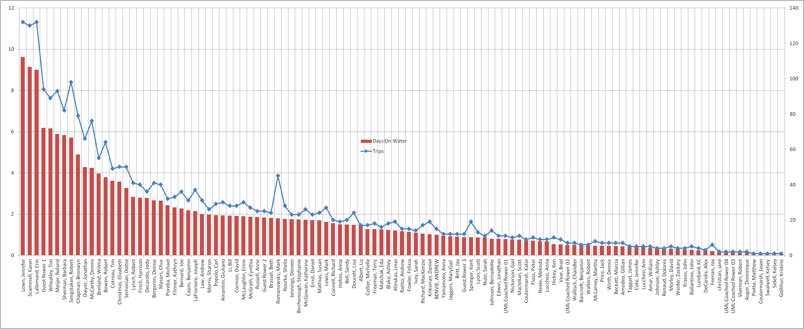
Total Rowing Days by Rower – J. Lown wins 3rd year in row

Slide 29
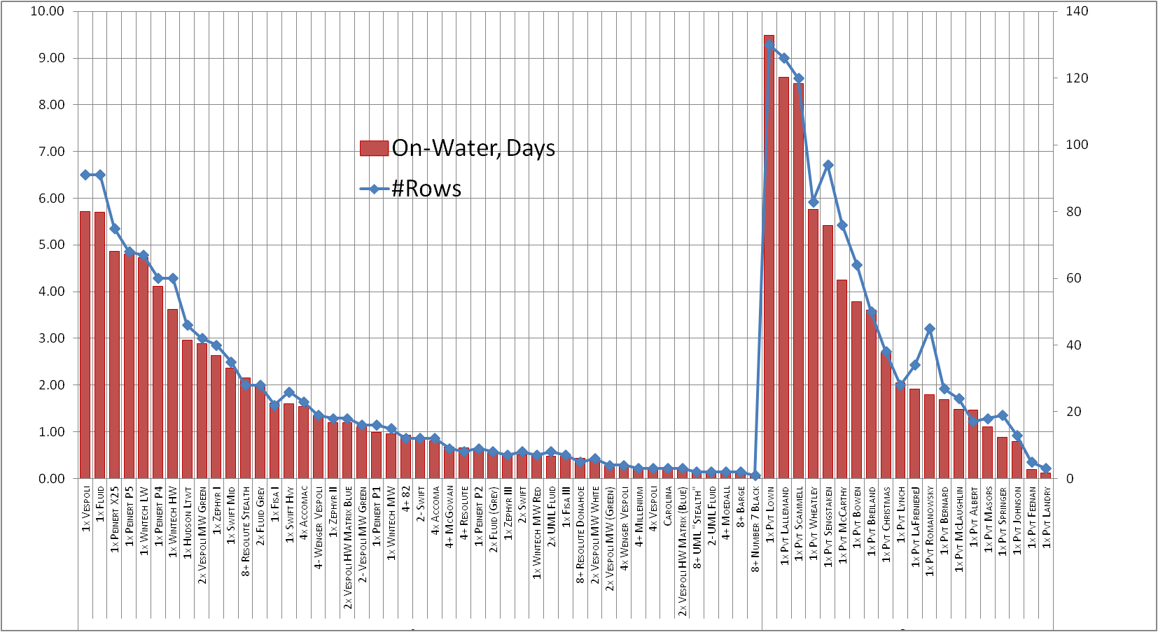
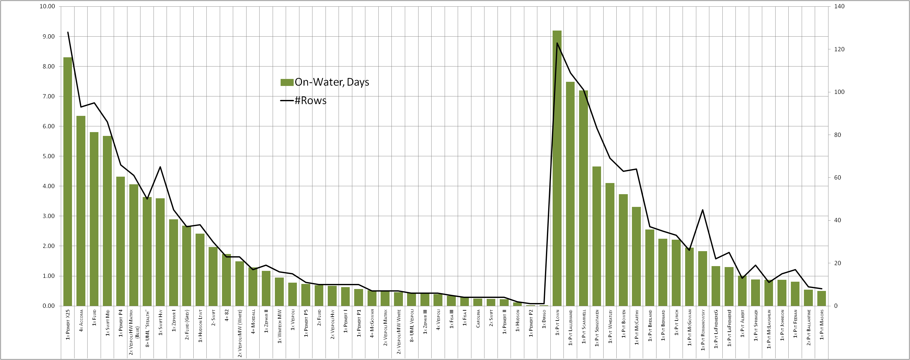
Total Rowing by Boat
Versus 2013. More different club
boats in 2014. Pvt boats remained constant at 20.

Slide 30
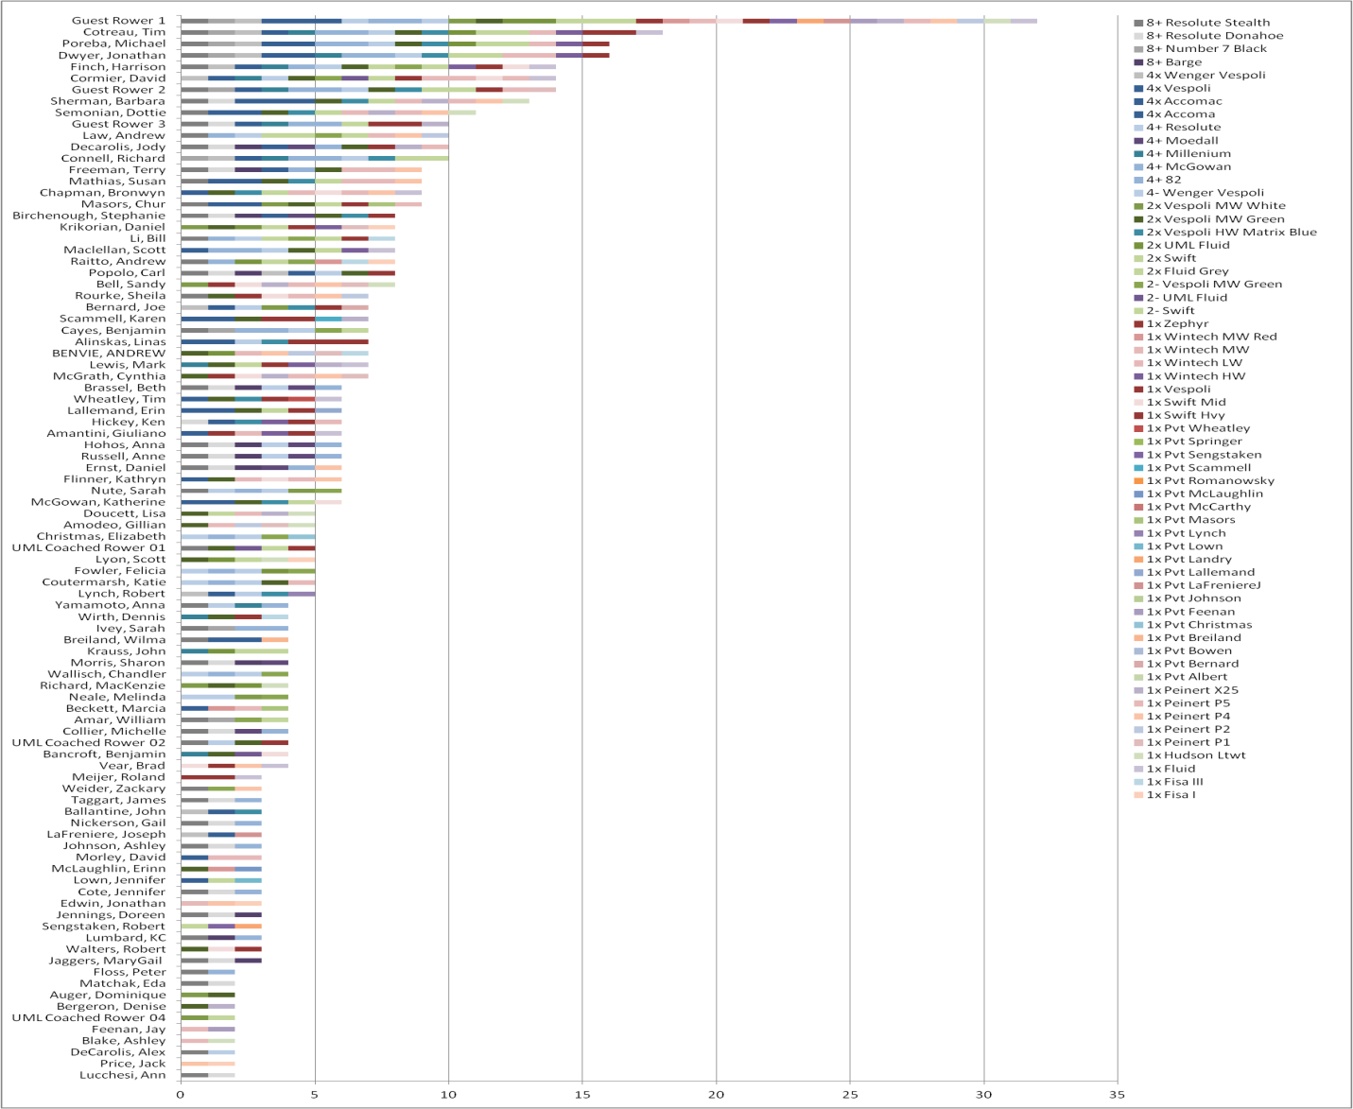
Most Flexible
Tim Coutreau rowed 18 different boats.
Not Shown: 18 people rowed only one boat.
Median for entire club was 4 different boats

Slide 31
Planning for Capital Equipment
The Equipment Committee will be working early 2015 on equipment needs
Assumptions of the past will continue
  Equipment purchase $ comes from regattas
  Our space is fixed at present allocation
Need to look at all boats and equipment
  Oars
  Wakeless launch
  Replace old Vespoli 2X and last old Peinert

Slide 32
Committees Open Enrollment
Equipment Committee
  Open, Chair -> seat new committee in January
Safety Committee
  Open, Chair (former Bob Lynch)
Membership/Programs committee
  Vice President and OPEN, Co-chairs
  Develop the programs and program management training for CY2015
Social
  Open, Chair (former Kathy McGowan)
Rack Policy Committee – continuing

Slide 33
Social Committee 2014
Providing opportunity for members to mix
Encourage group rows and coffee
March Meeting: St Patrick's Day snacks: Samples of MRRA outerwear.
April Meeting: On the Water! Samples of MRRA Clothing
June 7 th National Learn To Row Day- Breakfast- snacks
June 28 – 29th: NEMA and Festival Regattas- organized coolers for launches, breakfast and Lunch for regatta officials and volunteers
Saturday AM breakfast after session LTScull,..July
July 8 th Monthly Meeting: Cocktails on the deck, Invite recent LTR/LT sweep
** Through Summer/Fall organize Full Moon and Twilight Rows
** Mentoring for new members
Clothing for MRRA. Still have some items available

Slide 34
Approval of Base Membership
Increase Base Membership $25 to $150 for CY2015
Payment of Base Membership due by 15 January
Discount of $25 for payments postmarked or delivered to the hand of Treasurer/Secretary by 15 January (so $125 if paid on time)
Student rate of $75 membership and $75 off-peak logbook sculling
Rationale
  Base Membership defines voting rights
  Club has cash flow needs before rowing season starts for insurance, boathouse user fees
  High % of members paid by 15 January 2014

Slide 35
Approval of Definition of Student
Student is not defined in the bylaws
Proposed:
A Student membership rate is offered to anyone who has not reached his/her 23rd birthday at the time of membership
Rationale: We had several members who are adults and taking courses who have asked for student membership. The reason for the student membership is to help young people who are still in college and not yet fully in the workforce

Slide 36
Volunteering in Club
As an all-volunteer organization, it is imperative and a requirement of membership to volunteer
  Very high response for TRR and Festival volunteering
Need new blood on Equipment committee
  Very active and demanding committee
  More help makes less work for all

Slide 37
Volunteer of the Year Award
Barbara Sherman
Linas Alinskas
For going above and beyond consistently for the regattas this summer – we would have not have been as successful without your dedication and labors!

Slide 38
Appreciation
Thank you to our Program Managers
  Chur Masors – Learn to Scull
  Carl Popolo – Masters Sweep
  Jon Dwyer – Open Sweep Men
  Katie Coutermarsh – Open Sweep Women
  Linas Alinskas – Coached Sculling
  Terry Freeman and Jody Decarolis – LT Sweep
Thank you to our fabulous Coaches
  K.C. Lumbard - Alex Gavriel
  Mark Lewis - Robbie Walters

Slide 39
Appreciation
Thank you to our Regatta Directors
  Jay Feenan
  Peg Landry
  Carl Popolo
  Karen Scammell
  LOC for summer regattas:
    Dottie Semonian – Dave Morley – Linas Alinskas- Barbara Sherman – Bronwyn Chapman – Dennis McCarthy
Thank you to 2 tremendous spouses –
  Mike Power and John Breiland

Slide 40
Appreciation
Thank you to Committee Chairs
  Equipment: Bob Sengstaken
  Social: Kathy McGowan
  Safety: Bob Lynch
  Membership/Programs: Carl Popolo, Jason Holden, Karen Scammell
Thank you retiring board members
  Jason Holden, Trustee
  Jay Feenan, former president and VP
Thank you to our Webmaster Carl Popolo !!

Slide 41
Special Thank You to Jay Feenan
For his decades of service to the MRRA
Leadership in growing the TRR over the past 6-7 years
Improving relationships between the MRRA, the University and the Lowell City community

Slide 42
Annual Election of Officers

Slide 43
Detail slides for backup

Slide 44
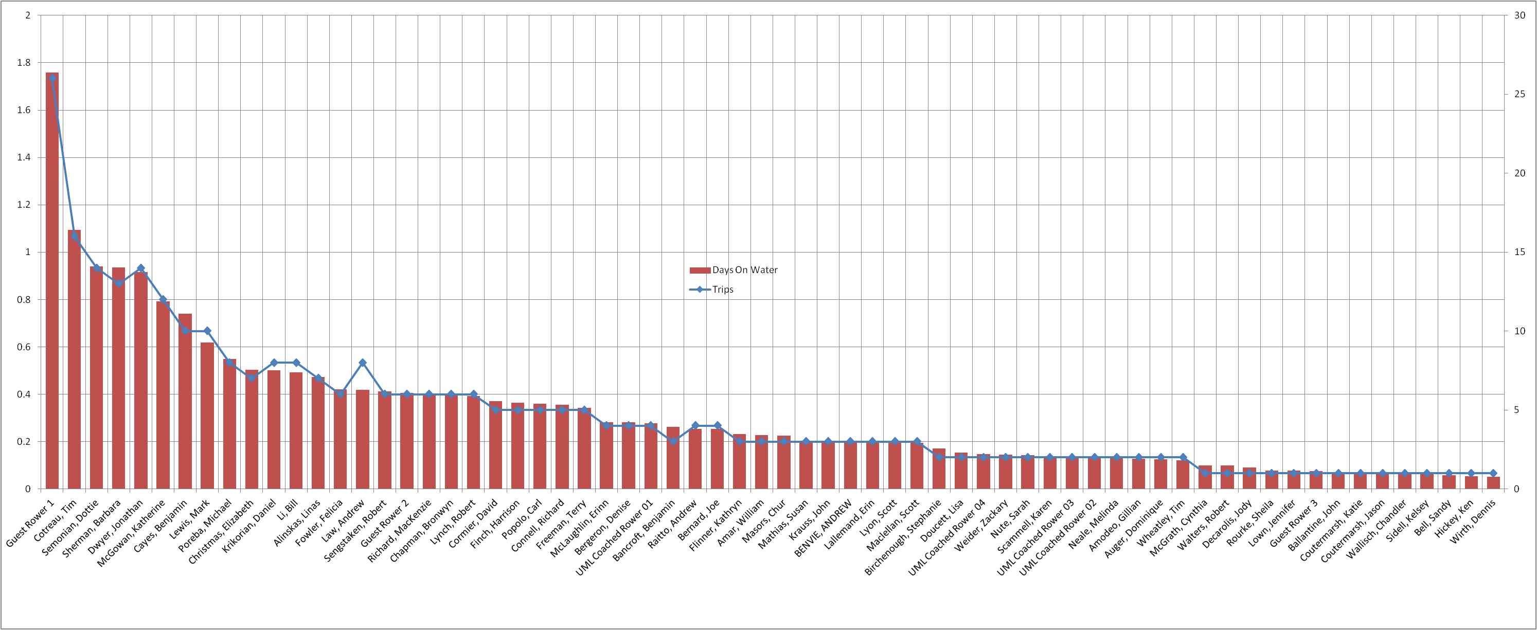
Total 2x/2- Rowing by Rower

Slide 45
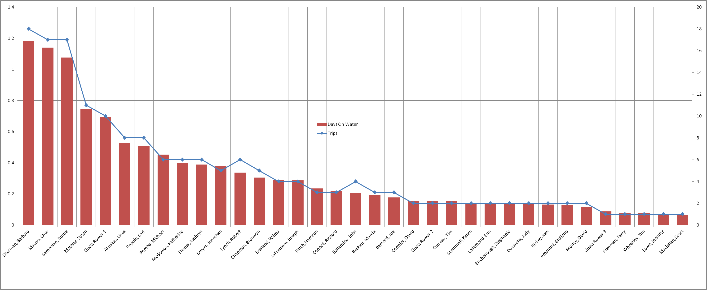
Total 4x Rowing by Rower

Slide 46
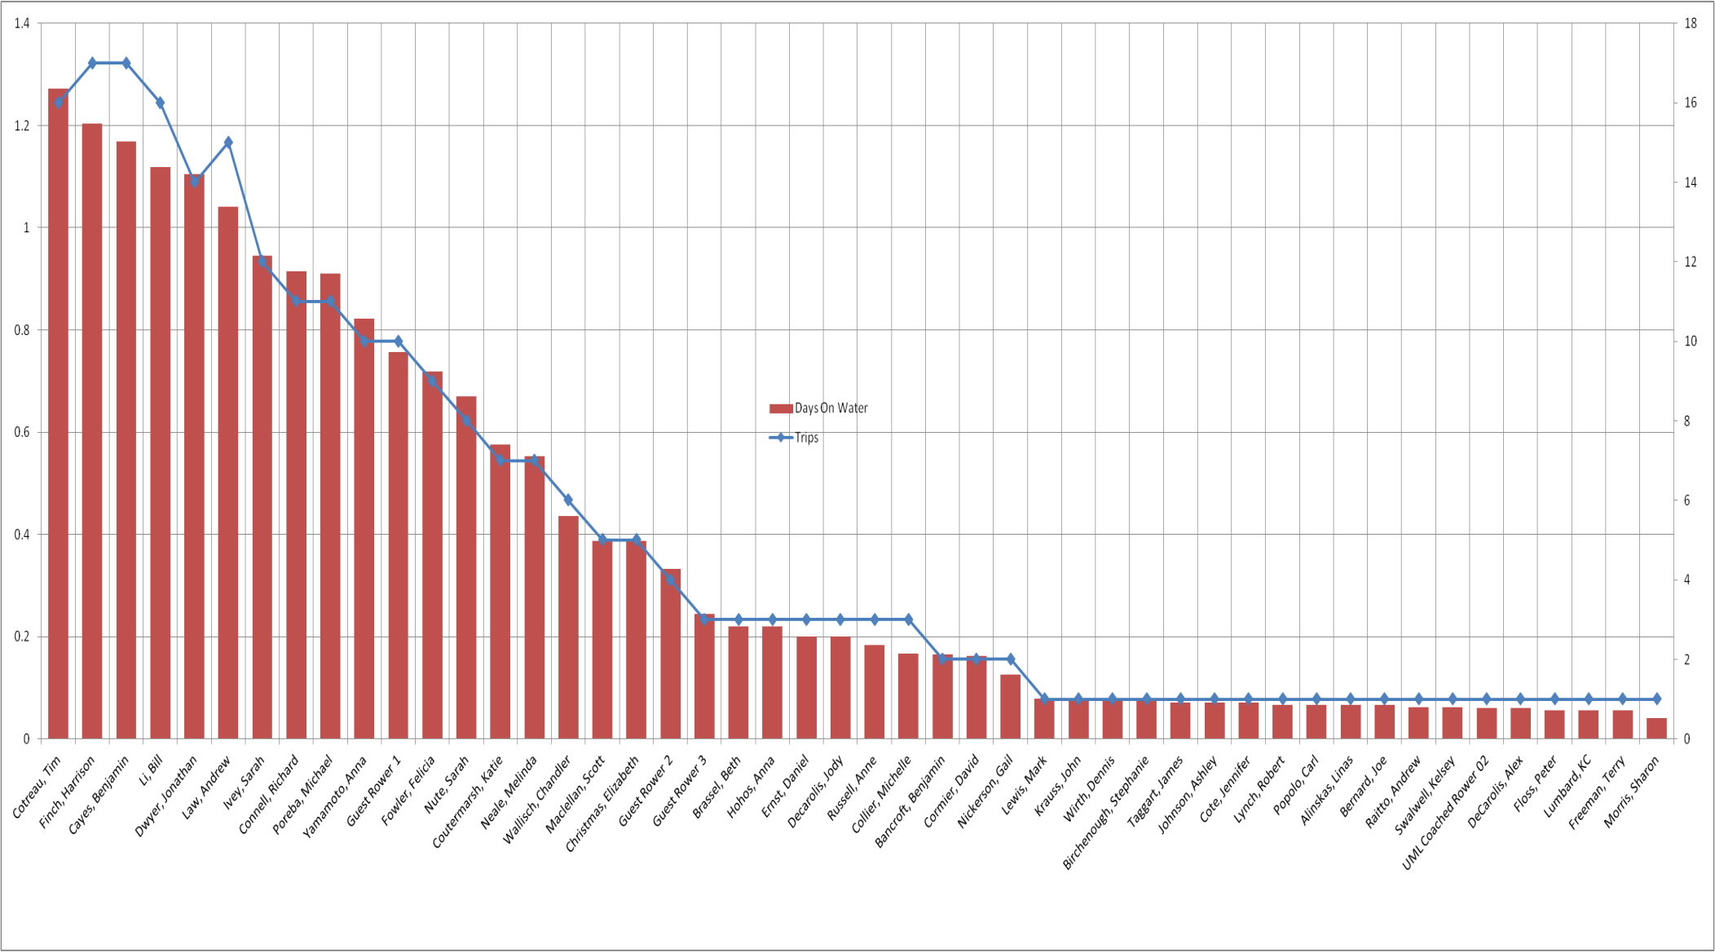
Total 4-/4+ Rowing by Rower

Slide 47
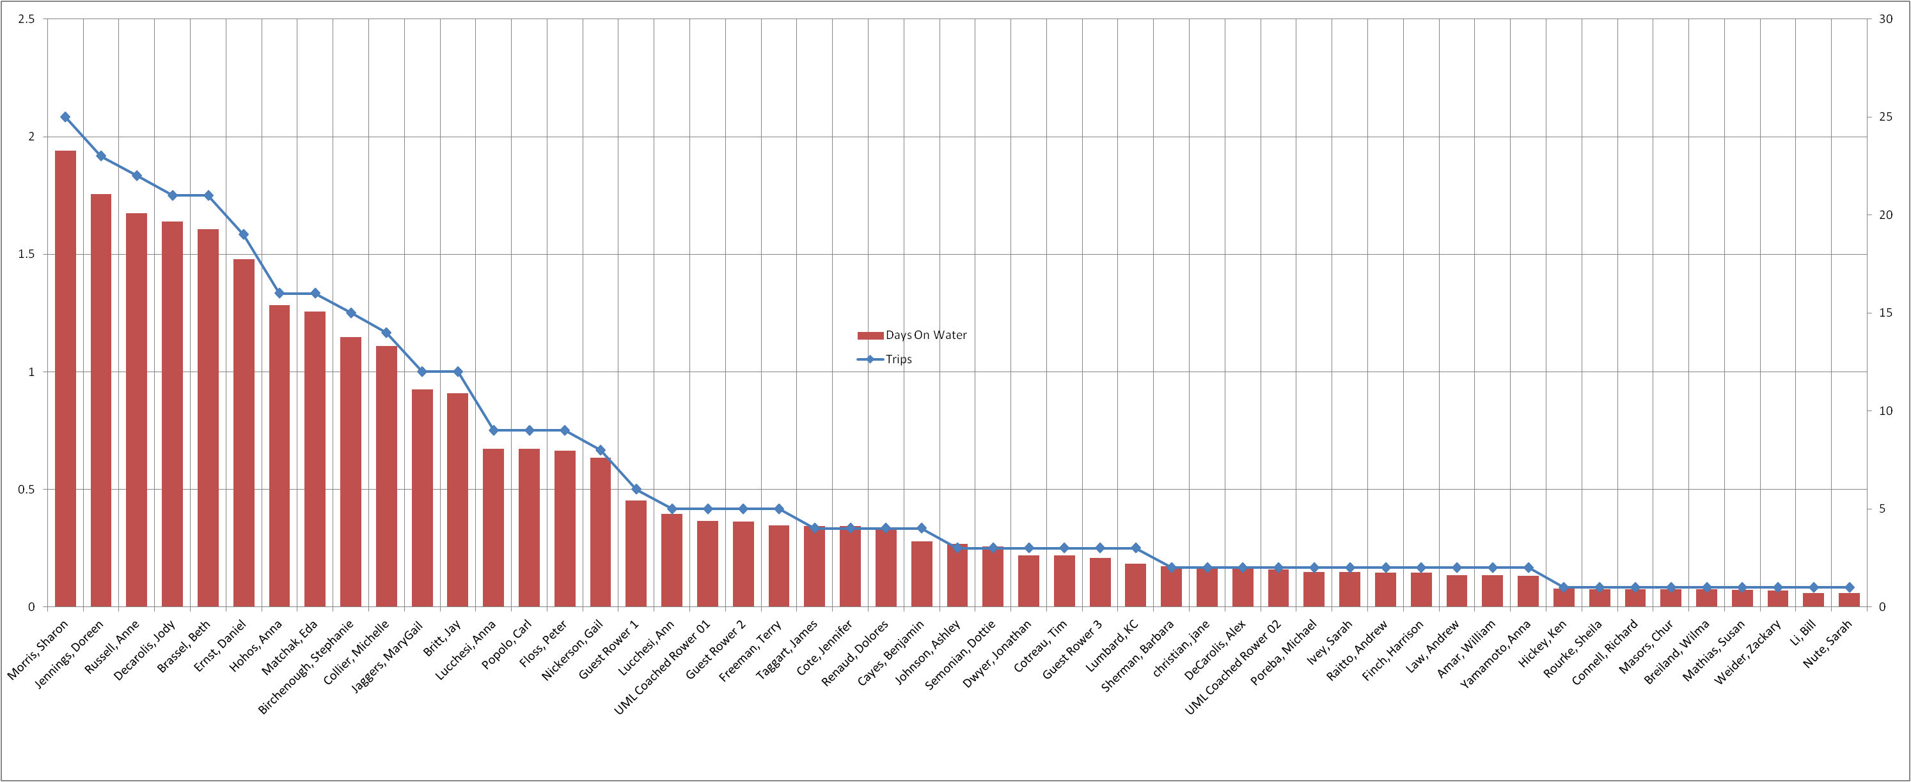
Total 8+ Rowing by Rower

