Slide 1
MRRA Annual Meeting
13 December 2022

Slide 2
Membership and Racks
Members: 70 total
  58 Regular Voting
Racks: 19 paid full
Learn to Scull – 15 Participants
  5 Joined MRRA
1 Lowell High School Graduating Senior Scholarship ($500)
6 Lowell High School Coaches received Non-Voting membership with Off-Peak sculling
22 UMASS Lowell Rowers took advantage of MRRA Scholarship – Non-voting membership with Off-Peak Sculling

Slide 3
Programs
Learn to Scull 1: 7 Participants
- 5 passed Captains test and joined MRRA
Learn to Scull 2: 8 Participants
Masters Scull: 9 Participants (program fee $69) - in addition to logbook sculling membership
Masters Sweep: Paid Logbook sculling and used MRRA/UML sweep boats at no charge

Slide 4
Financials
Program P & L |  | Base | Logbook | Rack | Learn To Scull | Learn To Sweep | Master Sweep | TOTAL
Revenue |  | $ 13,675 | $ 12,117 | $ 8,600 | $ 6,117 | $ - | $ - | $ 40,509
Expense |  | $ 16,565 | $ 4,936 | $ 7,336 | $ 6,396 | $ - | $ - | $ 35,231
Operating Profit |  | $ (2,890) | $ 7,182 | $ 1,265 | $ (279) | $ - | $ - | $ 5,278
Members |  | 58 | 33 | 19 | 7,8 | 0 | 0
Per full member rate |  | $ 285
BUDGET |  | MARCH | 2022
Program P & L |  | Base | Logbook | Rack | Learn To Scull | Learn To Sweep | Master Sweep | STU Sweep | TOTAL
Revenue |  | $ 15,100 | $ 9,600 | $ 8,925 | $ 3,900 | $ 4,200 | $ 3,900 | $ - | $ 45,625
Expense |  | $ 14,575 | $ 4,600 | $ 6,670 | $ 4,329 | $ 4,919 | $ 7,839 | $ - | $ 42,931
Operating Profit |  | $ 525 | $ 5,000 | $ 2,255 | $ (429) | $ (719) | $ (3,939) | $ - | $ 2,694
Members |  | 71 | 24 | 21 | 2*6 | 2*12 | 2*12 | 0
Per full member rate |  | $ 205

Slide 5
Note on Financials
No expenses for new Feenan Wakeless Launch, except registration
$1400 cost for Festival
  ≈ $850 is for medals which can be used in ’23
No charge for LHS Sweep boats; in exchange, MRRA allowed LHS coach supervised of sculling equipment

Slide 6
Boat Usage Stats

Slide 7
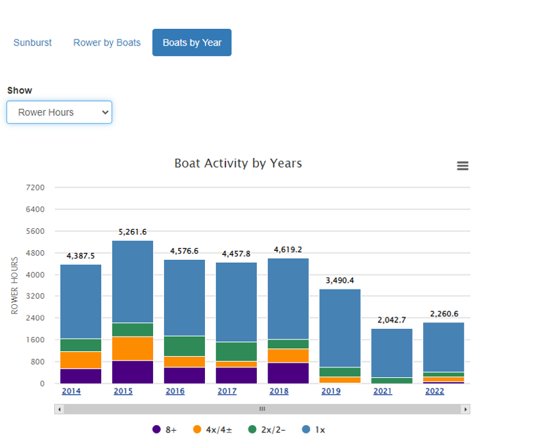

Slide 8
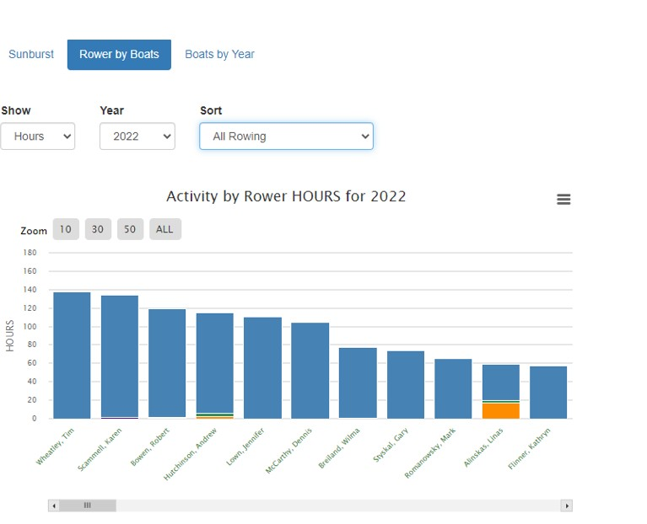

Slide 9
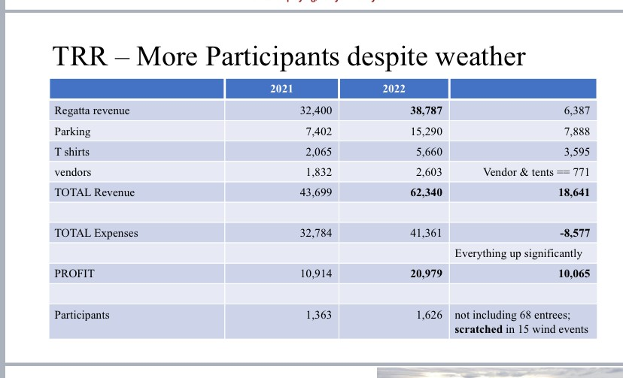
TRR Financials and Notes

Slide 10
Looking ahead to 2023
Continue to increase Membership
Grow Our Rowing Community - continue Learn to Row programs and partnerships with boathouse users
Festival Regatta Sunday June 25, 2023
Looking for Boatcaptain
  - And Committee Volunteers

Slide 11
Vote for 2023 Membership Fee
Motion from Karen Scammell to keep membership fees at $200 with $25 discount if paid by 15 January 2023

Slide 12
Sincere THANK YOU
•
Outgoing Board Members 2022
•
Carl Popolo - Web Master
•
LRRA Jessica Murray, Rob Waters
•
Linas Alinskas, Andy Hutchinson, Erin Heinhold

Slide 13
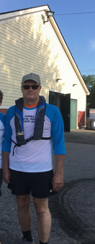
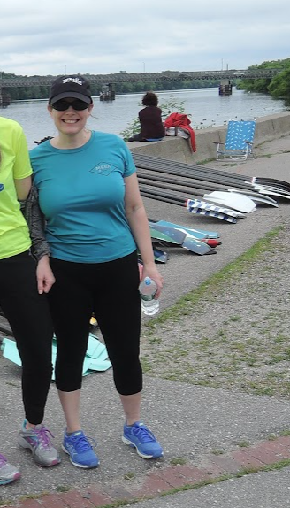
MRRA Volunteers of the Year
Linas Alinskas
Erin Heinhold

Slide 14
In Appreciation for Decades of Service, the TRR and MRRA Honor
Wilma and John Breiland
Bob and Mary Lynch
Mike Powers

Slide 15
Any other business?
Motion to adjourn….

